Slide 1
w1
Picturization No.1– from left side
No.11– from right side
x20 magnification in Aperio ImageScope
w5
w2
5 points in 1 vessel (cropped as shown)
↓
each width of the vessel is evaluated by image J
↓
mean of image J score
↓
normalize with the appropriate of length in the image
endothelial cells
w4
w3

Slide 2
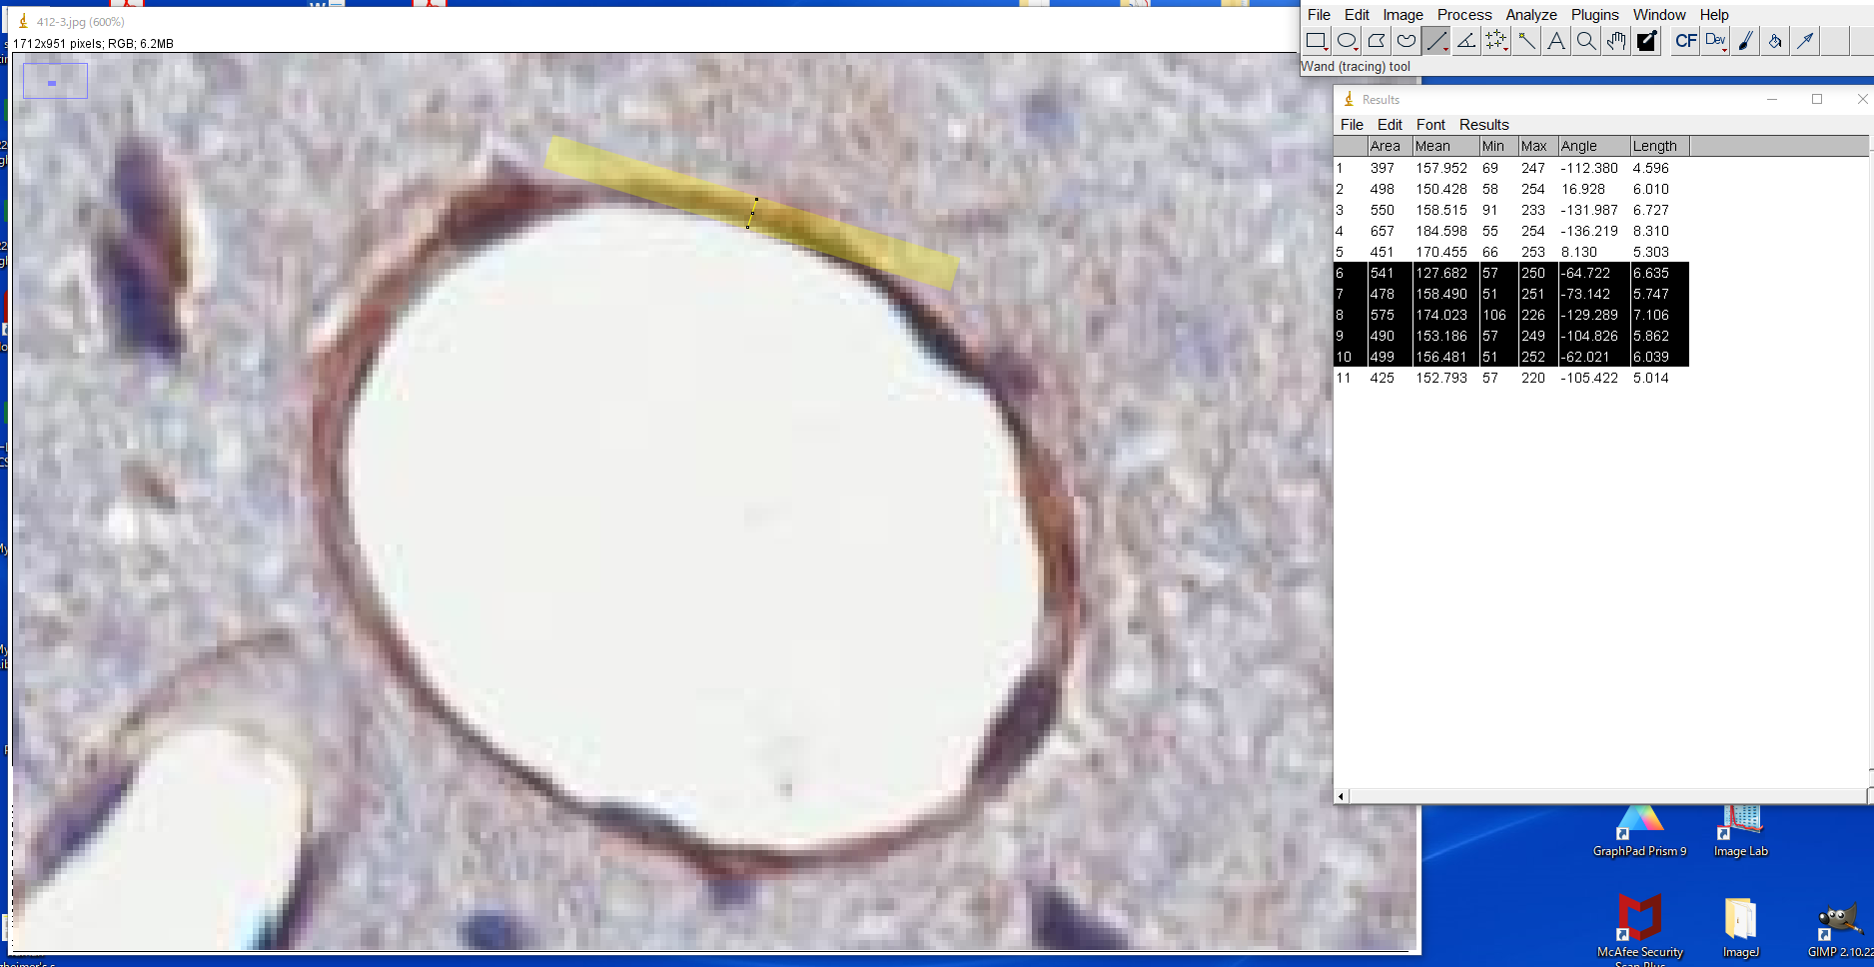
length from image J

